Slide 1

CS520 Data Integration, Warehousing & Provenance
Paper Review
Reptile: Aggregation-level Explanation for Hierarchical Data
Team : 27
Syed Wali Uddin Quadri- A20554645
Diego Escondrillas-

Slide 2
Introduction
What is Reptile?
An explanation system designed for hierarchical data, addressing limitations in existing query explanation
Systems.
Reptile takes a different approach, offering explanations for group-wise errors, such as missing records or
systematic value errors in hierarchical data.
Is Reptile a Methodology or System?
Reptile is more than just a single algorithm; it’s a methodology and a system
It combines various algorithms, optimizations, and techniques to create an
end-to-end approach for iterative error identification and repair in aggregation query results.

Slide 3
Contents of Reptile
Methodology
Algorithm
Iterative Error Identification and Repair
Multi-Level Model and EM-Based Training
Drill-downs
Dynamic and continuous improvement
Components
Evaluation & Experiments
Factorized Matrix Operations
Drill-Down Optimization
Comparisons and Evaluations
Experiments and Case Studies

Slide 4



Methodology
L1
Complaint: Profits too high!
Complaint: Statistics does not match
L2
L2
L3
L3
L4
L4
L4
L4
L4

Slide 5

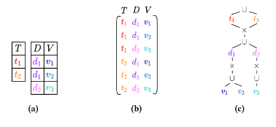
Components
Factorized Matrix Operations
| Drill-Down Optimization
State S
City C1
County C2
Area A

Slide 6
Algorithm
Multi-Level Model and EM-Based Training
The multi-level model used by Reptile is trained using the Expectation-Maximization (EM) algorithm
a standard technique for such models.
This involves various types of matrix multiplications:
gram matrix (X^T · X)
right multiplication (X · A),
left multiplication (B · X) (X is the full matrix).
Reptile outlines how these operations are on factorized matrices.
The goal is to avoid the computational cost of creating the full X matrix and instead operate directly on the f-representation.

Slide 7
Complaint
Reptile
Feature Generator
Database
Factorizer
Ranker
Interface
Auxiliary data
Model Trainer
Drill Down recommendation

Slide 8

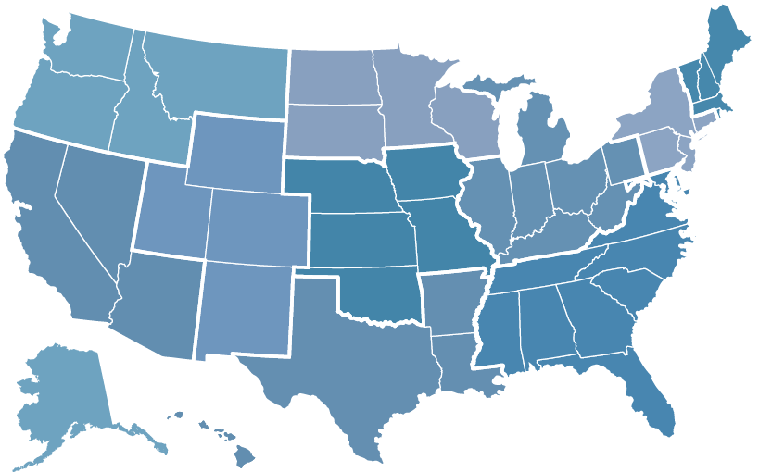


Understanding Reptile with Example!
Unusual Profits
Complaint
Reptile
8698 Stores in USA
Illinois S
S = State Level

Slide 9
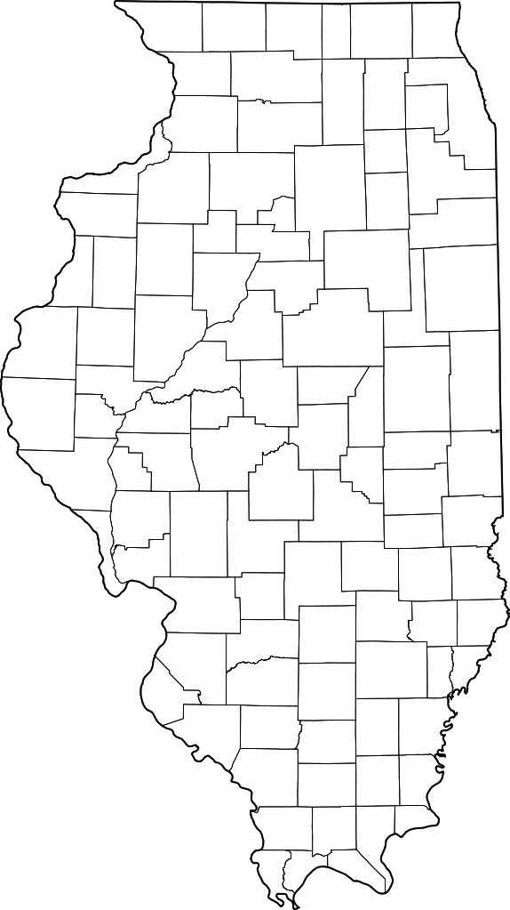
Understanding Reptile with Example!
564 Stores in Illinois
Complaint
Factorized Matrix
Reptile
Chicago C
C = City Level

Slide 10
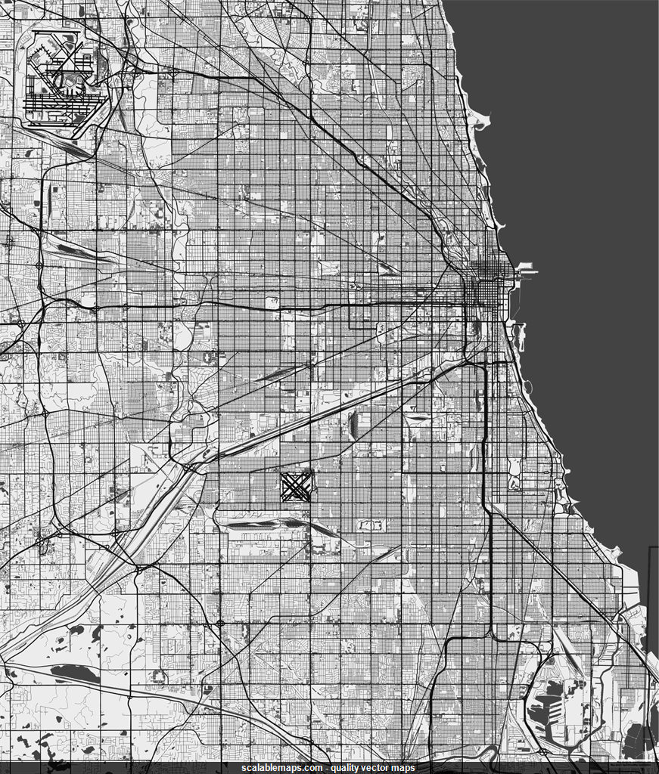
Understanding Reptile with Example!
Complaint
Factorized Matrix
Reptile
151 N State St A
C = Area Level
240 Stores in Chicago

Slide 11
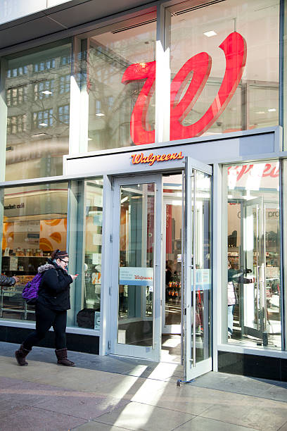
Understanding Reptile with Example!
Statistical and Human Error were found!
151 N State St

Slide 12


Evaluation and Experiments
COVID-19 data from John Hopkins
Ethiopian drought data from FIST

Slide 13
Q&A

Slide 14
Thankyou!
Team: 27
Syed Wali Uddin Quadri & Diego Escondrillas

